Slide 1
Let's Build a Quantum Computer!
31C3
29/12/2014
Andreas Dewes
Acknowledgements go to "Quantronics Group", CEA Saclay.
R. Lauro, Y. Kubo, F. Ong, A. Palacios-Laloy, V. Schmitt
PhD Advisors: Denis Vion, Patrice Bertet, Daniel Esteve

Slide 2
Motivation

Slide 3
Outline
Quantum Computing
What is it & why do we want it
Quantum Algorithms
Cracking passwords with quantum computers
Building A Simple Quantum Processor
Superconductors, Resonators, Microwaves
Recent Progress in Quantum Computing
Architectures, Error Correction, Hybrid Systems

Slide 4
Why Quantum Computing?
Quantum physics cannot be simulated efficiently with a classical computer.¹⁾
A computer that makes use of quantum mechanics can do it.
It can also be faster for some other mathematical problems.
1) http://www.cs.berkeley.edu/~christos/classics/Feynman.pdf

Slide 5
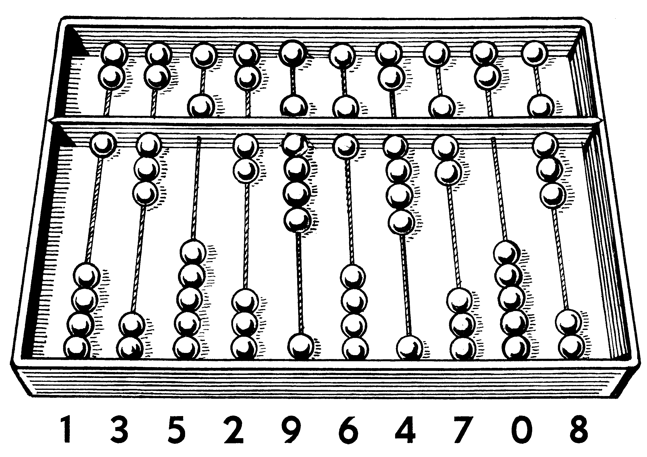
Classical Computing
http://commons.wikimedia.org/wiki/File:Abacus_1_(PSF).png

Slide 6
Bits
0
1
0 V
5 V

Slide 7
Bit Registers
In_{A}
n bits
In_{B}
...
In..
$N=2^{n}$ states
$$0…00, 0…01,…,1…11$$

Slide 8
Logic Gates
In_{A}
f
In_{B}
Out

Slide 9
Logic Gates
NAND-Gate
In_{A}
f
In_{A} | In_{B} | Out
0 | 0 | 1
0 | 1 | 1
1 | 0 | 1
1 | 1 | 0
In_{B}
Out

Slide 10
A problem: Password cracking
************
Launch Missile
Forgot your pasword?

Slide 11
A Password Checking Function
In_{A}
f_{j}
In_{B}
$N=2^{n}$ possibilities
...
In..
Out
$$f=\left\{\begin{matrix}0 & i≠j \\ 1 & i=j\end{matrix}\right.$$
$$i,j ∈\left\{00…000,00…001,…,11…111\right\}$$

Slide 12
A Cracking Algorithm
Set register state to i = 00000...0
Calculate f(i)
If f(i)= 1, return i as solution
If not, increment i by 1 and go to (2)

Slide 13
Time Complexity of our Algorithm
O(N)
number of evaluations of f
search space size - N

Slide 14
Quantum Computing

Slide 15
Quantum Bit / Qubit
|1>
|0>
Qubit ≈ Two-Level Atom

Slide 16
Quantum Superposition
|1>
|0>
ϕ
$\left.|ψ\right\rangle$=$\left.\sqrt{a}|0\right\rangle +\left.\sqrt{1−a}{∙e}^{iφ}|1\right\rangle$

Slide 17
How to imagine superposition
http://en.wikipedia.org/wiki/Double-slit_experiment#mediaviewer/File:Doubleslit3Dspectrum.gif

Slide 18
Quantum Measurements
|1>
|0>
0
1
$\left.|ψ\right\rangle$=$\left.\sqrt{a}|0\right\rangle +\left.\sqrt{1−a}{∙e}^{iφ}|1\right\rangle$

Slide 19
Quantum Measurements
|0>
0
1
$\left.|ψ\right\rangle$=$\left.|0\right\rangle$ ; probability = a

Slide 20
Quantum Measurements
|1>
0
1
$\left.|ψ\right\rangle$=$\left.|1\right\rangle$ ; probability = 1-a

Slide 21
QuBit Registers
$$\left.|A\right\rangle$$
$$\left.|B\right\rangle$$
...
$$\left.|Z\right\rangle$$
$$\left.|A\right\rangle \left.|B\right\rangle \left.…|Z\right\rangle$$

Slide 22
QuBit Registers
$$\left.|A\right\rangle$$
$$\left.|B\right\rangle$$
...
$$\left.|Z\right\rangle$$
$$\left.|AB…Z\right\rangle$$

Slide 23
Multi-Qubit Superpositions
$${0.5}^{1/2}\left(\left.|0\right\rangle +\left.|1\right\rangle \right)$$
$${0.5}^{1/2}\left(\left.|0\right\rangle +\left.|1\right\rangle \right)$$
...
$${0.5}^{1/2}\left(\left.|0\right\rangle +\left.|1\right\rangle \right)$$
n times
$${0.5}^{n/2}\left(\left.|0\right\rangle +\left.|1\right\rangle \right)…\left(\left.|0\right\rangle +\left.|1\right\rangle \right)$$

Slide 24
Multi-Qubit Superpositions
$${0.5}^{1/2}\left(\left.|0\right\rangle +\left.|1\right\rangle \right)$$
$${0.5}^{1/2}\left(\left.|0\right\rangle +\left.|1\right\rangle \right)$$
...
$${0.5}^{1/2}\left(\left.|0\right\rangle +\left.|1\right\rangle \right)$$
$N=2^{n}$ states in superposition
$${0.5}^{n/2}\left(\left.|00…0\right\rangle +…+\left.|11…1\right\rangle \right)$$

Slide 25
Multi-Qubit Superpositions omitting normalizations
$$\left.|0\right\rangle +\left.|1\right\rangle$$
$$\left.|0\right\rangle +\left.|1\right\rangle$$
...
$$\left.|0\right\rangle +\left.|1\right\rangle$$
$$\left.|00…0\right\rangle +…+\left.|11…1\right\rangle$$

Slide 26
Quantum Gates
$$\left.|0\right\rangle +\left.|1\right\rangle$$
$$\hat{f}$$
$$\left.|0\right\rangle +\left.|1\right\rangle$$
...
$$\left.|0\right\rangle +\left.|1\right\rangle$$
$\left.|0…00∙\hat{f}(0…00)\right\rangle +\left.|0…01∙\hat{f}(0…01)\right\rangle$+$\left.…+|1…11∙\hat{f}(1…11)\right\rangle$

Slide 27
Quantum Entanglement
$$\left.|01\right\rangle +\left.|10\right\rangle$$
$$\hat{f}$$
0
1
$$\left.|0\right\rangle$$
$$\left.|1\right\rangle$$
$$\left.|1\right\rangle$$
$$\left.|0\right\rangle$$
$$\hat{f}(|01⟩)=\left.|01\right\rangle +\left.|10\right\rangle$$

Slide 28
Summary: Qubits
Quantum-mechanical two-level system
Can be in a superposition state $\left.|0\right\rangle +\left.|1\right\rangle$
A measurement will yield either 0 or 1 and project the qubit into the respective state
Can become entangled with other qubits

Slide 29
Back to business...
************
Launch Missile
Wrong password!

Slide 30
Quantum Searching our Password
$$\left.|0\right\rangle +\left.|1\right\rangle$$
$${\hat{f}}_{j}$$
$$\left.|0\right\rangle +\left.|1\right\rangle$$
...
$$\left.|0\right\rangle +\left.|1\right\rangle$$
$\left.|0…000\right\rangle +\left.|0…010\right\rangle$+$\left.|01…101\right\rangle +\left.|1…110\right\rangle$

Slide 31
But how we get the solution?
$$\left.|0\right\rangle +\left.|1\right\rangle$$
f_{j}
0
1
$$\left.|0\right\rangle +\left.|1\right\rangle$$
0
1
...
$$\left.|0\right\rangle +\left.|1\right\rangle$$
0
1
0
1
$$result= \left\{\begin{matrix}01…101 & p=\frac{1}{N} \\ ∗∗…∗∗0 & p=1−\frac{1}{N}\end{matrix}\right.$$
☹

Slide 32
Solution: Grover Algorithm
repeat $\sqrt{N}$ times
f_{j}
Grover Operator
0
1
$$\left.|0\right\rangle +\left.|1\right\rangle$$
$$\left.|0\right\rangle +\left.|1\right\rangle$$
0
1
...
$$\left.|0\right\rangle +\left.|1\right\rangle$$
0
1
0
1
☺
$$result= \left\{\begin{matrix}01…101 & p≈1 \\ ∗∗…∗∗0 & p≈0\end{matrix}\right.$$
Grover L.K.: A fast quantum mechanical algorithm for database search, Proceedings, 28th Annual ACM Symposium on the Theory of Computing, 1996

Slide 33
Efficiency of Grover Search (for 10 qubits)
≈ 25 iterations
required
N = 1024

Slide 34
Time Complexity Revisited
classical algorithm - O$\left(N\right)$
number of evaluations of f
quantum
speed-up
O$\left(\sqrt{N}\right)$
Grover Algorithm
search space size – N

Slide 35
Number Factorization: Shor Alg.
$r=q∙s;$ q,s prime numbers
classical algorithm –
exp(1.9log[N]^{1/3}log[log[n]]^{2/3})
Runtime
Shor algorithm – log(n)³
problem size – n (number of bits)

Slide 36
How to Build a Quantum Processor?

Slide 37
photo not CC-licensed
photo not CC-licensed
University of Innsbruck (http://www.quantumoptics.at/)
University of Santa Barbara (http://web.physics.ucsb.edu/~martinisgroup/)
Ion Trap Quantum Processors
Superconducting Quantum Processors
...and many more technologies:
Nuclar magnetic resonance,
photonic qubits, quantum dots,
electrons on superfluid helium,
Bose-Einstein condensates...

Slide 38
A Simple Two-Qubit Processor Using superconducting qubits (Transmons - Wallraff et al., Nature 431 (2004) )
38
a)
1 mm
100 μm
1μm
Dewes et al. Phys. Rev. Lett. 108, 057002 (2012)
Notes:
We realize this processor on a silicon chip, shown here. The two readout resonators and the fast flux lines are realized as coplanar waveguides by optically patterning a thin Niobium film. The two qubits with the coupling capacitor are located in the center of the chip. The Josephson junctions and qubit capacitance, shown here, are fabricated by double-angle evaporation of Aluminium through a resist mask patterned by electron-beam lithography.

Slide 39
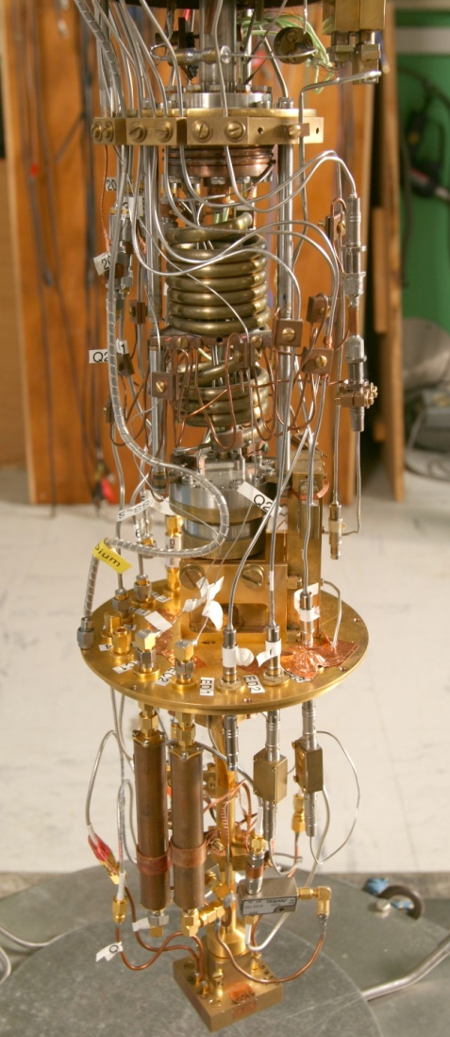
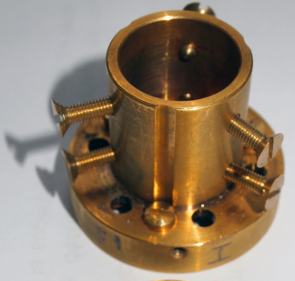
39
mount on microwave PCB and wirebond
put in dilution cryostat
*
20 mK
thermally anchor and
shield from EM fields
Notes:
To perform measurements, this chip is first glued to a custom-made microwave PCB, which is itself attached to a sample holder made of Copper, which is in turn attached to the 20 mK stage of a dilution cryostat and connected to room-temperature electronics using cryogenic wiring. Each qubit possesses its own drive and readout circuit, which is shown for one of the qubits here. Besides a common magnetic coil, each qubit possesses its own filtered and attenuated fast flux line, shown in red. Single-qubit drive signals are generated by mixing the continous output of a microwave source with fast control pulses. The resulting signal then gets filtered and attenuated on its way to the qubit chip. Readout signals are generated by the same method and sent to the qubit chip through the same input line. The reflected microwave signals get amplified and filtered at 4 K and room temperature, where the reflected readout signal gets demodulated and digitized.

Slide 40
Running Grover-Search for 2 Qubits
40
Prepare superposition
Calculate f_{j}
Apply Grover operator
Readout
|0>
Y_{π/2}
iSWAP
Z_{-π/2}
iSWAP
X_{π/2}
0
1
|0>
Y_{π/2}
Z_{-π/2}
X_{π/2}
0
1
readout
Y(π/2)
iSWAP
Z(±π/2)
iSWAP
X(π/2)
f₀₁[φ(t)], a(t)
0
50
100
150
200 ns
Notes:
So, instead of measuring the density matrix of the resulting output state by tomography, we now directly measure the result of the algorithm without correcting any readout errors, just performing a 1->2 qubit transition to increase readout fidelity.
Doing this for Oracles implementing all four possible search functions f and averaging the obtained results in each case over many identical runs of the algorithm, we obtain the success probabilities of the different implementations of the search algorithm.

Slide 41
Single-Run Success Probability
41
Prepare superposition
Calculate f_{j}
Apply Grover operator
Readout
|0>
Y_{π/2}
iSWAP
Z_{±π/2}
iSWAP
X_{π/2}
0
1
|0>
Y_{π/2}
Z_{±π/2}
X_{π/2}
0
1
f₀₀
f₀₁
f₁₀
f₁₁
67 %
62 %
55 %
52 %
classical benchmark
(with "I'm feeling lucky"
bonus)
Dewes et. al., PRB Rapid Comm 85 (2012)
Notes:
Here I show you these probabilities together with the corresponding error rates for the four possible search functions, as indicated above. Comparing the success probabilities, which range between 52 and 67 % to those of the classical benchmark algorithms of 25 and 50 % respectively, demonstrates thus that we are indeed able to achieve quantum speed-up with our processor for this simple algorithm.

Slide 42
Challenges
Decoherence
Environment measures and manipulates the qubit and destroys its quantum state.
Gate Fidelity & Qubit-Qubit Coupling
Difficult to reliably switch on & off qubit-qubit coupling with high precision for many qubits
And some more:
High-Fidelity state measurement, qubit reset, ...

Slide 43
Recent Trends in Superconducting Quantum Computing

Slide 44
Better Qubit Architectures
Better Qubits and Resonators
Quantum Error Correction
Hybrid Quantum Systems
(photos not included since not CC-BY licensed)

Slide 45
Moore's Law: Quantum Edition (for superconducting qubits)
3D Cavities
Circuit QED
Quantronium
Cooper pair box

Slide 46
Summary
Quantum computers are coming!
...but still there are many engineering challenges to overcome...
Bad News
Likely that governments and big corporations will be in control of QC in the short term.

Slide 47
Thanks!
More "quantum information":
Diamonds are a quantum computer’s best friend – Tomorrow, 30.12 at 12:45h in Hall 6 by Nicolas Wöhrl
Get in touch with me:
ich@andreas-dewes.de // @japh44

